Slide 1

A Tea Online Shopping Website - Teamee
Created by Holly Do
MSE Project

Slide 2

Table of Contents
Abstract
Introduction
Background
Motivation
Objectives
Resources
Work Products
SRS Document
Design Document
Laravel
Scrum
Iteration 1
Iteration 2
Iteration 3
Conclusion

Slide 3

Abstract
This project is an online tea and coffee store that provides users with information about the Teamee company, and allow the user to place orders on the website. Ecommerce is a blooming industry that encompasses various goods and services.³ It is necessary in today’s world for any company that sells products or services to have a website. The Teamee website is highly customizable and uniquely different from the typical Wordpress website.
This is a developmental project; thus, the core of the report would be within all my documentations of my project. There will be a total of three documents: the SRS, design, and test plan. The SRS document provide a detailed description of the Teamee system. The design document contains an outline of how the Teamee system will be implemented to satisfy all the requirements listed in the SRS. Finally, the test plan document will contain the methods that were used to ensure that the Teamee system is held to the highest quality. However, the primary document for my project would be the SRS (software requirement specification). It contains all the information necessary to describe what my project is about and a full description of the Teamee system.
The creation of the Teamee website will help increase its potential customer base. Anyone with internet access can view the website. Also, the Teamee online store provides users a convenient way to skip the line and procure goods from Teamee to satisfy their craving. The convenience is extended to employees since the online store will also be beneficial for Teamee’s employees. The Teamee system will provide a way for admin to track and fulfill orders. Additionally, by providing information about the stores and products provided by Teamee, this will reduce questions that customers will have.

Slide 4
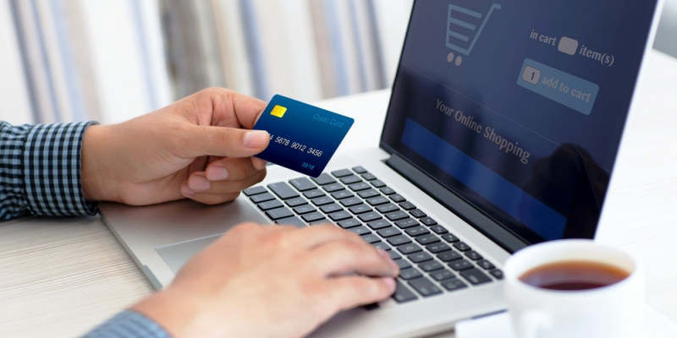
Introduction
Ecommerce website
Allows users to place orders and pickup in store
User can learn about the company
Items sold by the company
Store’s locations
Notes:
Online shopping has increased steadily throughout the years. Consumers increasingly looking towards online websites to procure goods and services. Thus, companies need to have their own website to attract potential customers. According to IBIS world, more people are connected online through their phones and online retail stores are a billion-dollar industry.² In the future, any company will need a website to provide information about itself or sell products or services. Therefore, it is necessary to learn how to develop attractive and responsive website.
In addition, the food industry has been penetrating the online markets. For instance, Starbucks have a well-developed website and app to attract and retain their fans. Even Uber had created an app to deliver food. Dominos is another prime example of this trend since it allows the user to create and customize their pizza order. The website is easy to use and convenient to operate since it provides a full menu of Dominos’ selection. These flourishing examples demonstrated how services and goods can be rendered successfully online.
Food trends are constantly shifting, especially in regards to dessert. In the past, there were boba craze, ice cream, cupcakes, and other delectable treats that materialized. The US have a sweet tooth and it has proven to be insatiable.

Slide 5

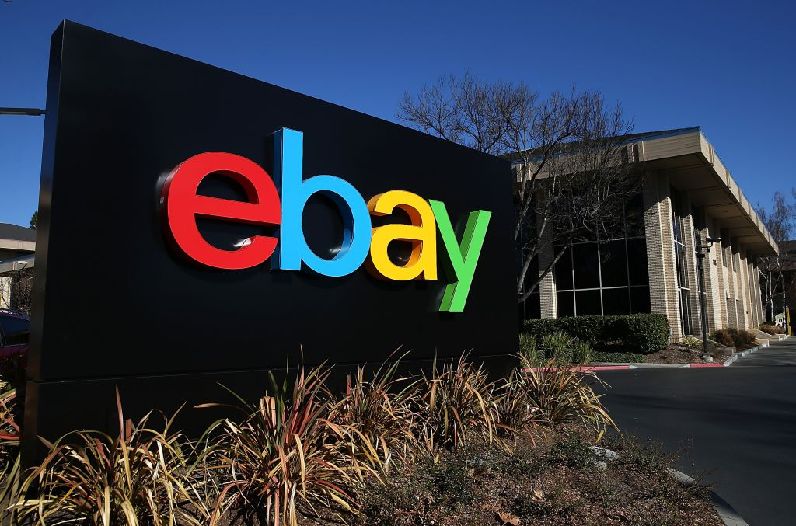
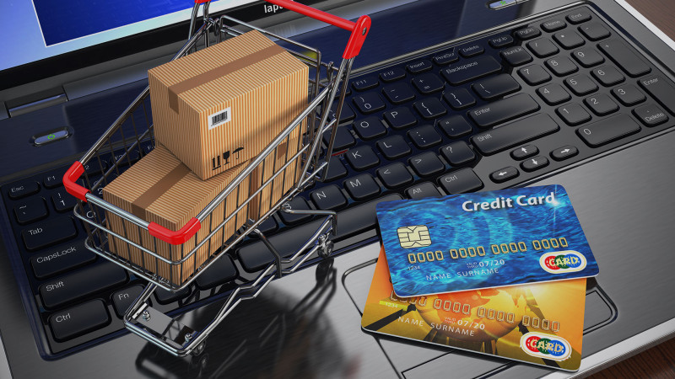
Background
Generally, when ecommerce sites are mentioned, people think of Amazon, eBay, or other big name retailors. All kinds of products are sold on these websites. Then the food industry began to enter the internet space. In recent years, an emergence of websites and apps appear that allows consumers to order food or drinks online and have them delivered or ready to be picked up. Consumers have been shifting away from placing food or drink orders using the phone; and instead, they are using the internet to place orders.

Slide 6

Motivation
My motivation for this project stems from the fact that I love tea. I hope to one day open a tea place for people to congregate and relax. I’ve always enjoyed gathering at a tea place with my friends; thus, it is my wish to own one in the future. This project had provided me with an opportunity to create a website and web app for my prospective store. Additionally, creating the Teamee web app had provided me with a project to show prospective employers. By building an ecommerce application, I had demonstrated a highly marketable skill as the ecommerce field is blooming. Furthermore, this project will help me demonstrate my ability to formulate a whole project from start to end.

Slide 7

Objectives
The objective is to create a functioning website and web app with an easy to use UI. The creation of the website and web app serves the following purpose:
Improve programming skills
Improve upon existing programming languages
Learn new languages such as SQL to implement the backend of the project.
Demonstrate to future employers the capability to complete a whole project
Create an effective software process to develop the Teamee website and web app
Provide evidence of software process

Slide 8

Resources
3.1 Hardware
The hardware that was used to create this project is a Lenovo Thinkpad E570 with an Intel i7 core. The laptop is running with Microsoft Windows 10 Pro.
3.2 Software
4.2.1 Frameworks: Bootstrap v3.3.6, Materialize, Laravel
4.2.2 Microsoft Office 2016
4.2.3 Microsoft Visio 2013
4.2.4 GitHub
4.2.5 Adobe Photoshop 2017
Notes:
I chose Bootstrap and Materialize as my frameworks for the UI because it is one that I am closely familiar with. I have used it to develop webpages before so I am confident that I can use it to create the UI for my website. Laravel was also chosen based upon previous work experience.
GitHub will be used as my source control and repository. GitHub was chosen because it is one of the most popular Git repository hosting service and I have used it before for work. As a result, it would be one less thing for me to learn.
Adobe Photoshop was used to design the logo and other photo manipulations. The main use of Photoshop was to crop pictures, logo placement in pictures, and modification of pictures. For a website to be attractive to users, it was necessary to produce quality pictures.

Slide 9
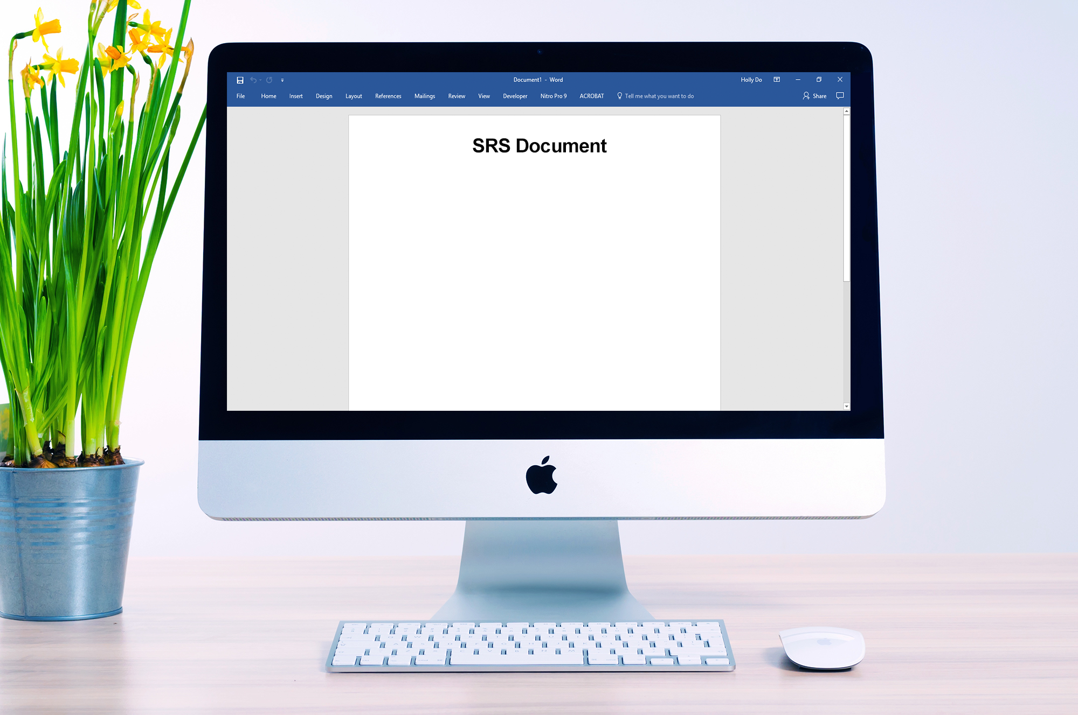
System Features
Functional Requirements
User Characteristics
Use Cases
Notes:
The purpose of this Software Requirement Specification (SRS) document is to provide a thorough description of the software requirements for the Teamee web application. This document can be used to foster a better understanding of the Teamee web app and elucidate stakeholders of the software requirements. The requirements stated in this document are subjected to changes, and any changes shall be updated within this document. This documented is intended for its stockholders such as its software developers, project managers, and users.
Teamee web app is tended to provide customers and potential customers information about Teamee which includes its products, locations, and services. This web app will be available for anyone with an internet access. Users can place their orders online and pickup in store. Administrators will be able to view all recent and past orders.

Slide 10
System Features
ABOUT US: Provides information about the company.
LOCATIONS: Provides the nearest store locations based on zip code
MENU: Provides a list of all the products that Teamee sells.
CONTACT US: Allows users to send an email message to Teamee.

Slide 11


User Characteristics
Users are people who accessed the website. Users are permitted to access the entire website. A free account is provided to any user who wishes to make one.
Administrators are responsible to take care of the Teamee website and messages. Administrators must login to gain access to the administrator portal. The administrator will be able to view users’ account information, but not the user’s password. The administrator can view current, past, and future orders made by users.

Slide 12
Use cases
ID and Name: | UC-1 Register for account
Primary Actor: | User
Description: | The user shall register for an account on Teamee by clicking of the Register link. The user must enter his/her email information, username, and password to register.
Trigger: | User accessed Teamee’s website and clicked on the Register link to register for an account.
Preconditions: | PRE-1 User must have a valid email address PRE-2 Username must be available PRE-3 Password must be at least 6 characters long
Postconditions: | POST-1 Teamee shall send a verification email to the user’s email POST-2 The user shall click on the verification link in the email POST-3 The user’s information shall be stored in the Teamee’s database
Normal Flow: | Register for an Account User click on the Register link on the Teamee web app User enter a valid email address User enter a username that is available User enter a password that is at least 6 characters long User click submit button System shall display a confirmation screen that tell the user to check his/her email for verification
Alternative Flow: | 1.1 Sign-in to a Registered Account 1. User with an existing account shall sign into his/her account 2. User sign in using his/her email with the correct password
Exceptions: | E1 Invalid email address E2 User name is taken E3 Password is not long enough E4 Password does not match confirm password
Priority: | High
Frequency of Use: | Dozens of users a day.
Other Information | N/A
Assumptions: | AS-1 User have an email address AS-2 Peak usage when web app first become available
ID and Name: | UC-2 Add Item to Cart
Primary Actor: | User
Description: | The user can browser drinks and products sold by Teamee and select products to be added to his/her shopping cart.
Trigger: | User accessed Teamee’s website and clicked on the Menu link located in the navigation bar. In the Menu page, the user can click on a product and click on the Add to Cart button.
Preconditions: | PRE-1 User must be in the Menu page PRE-2 User set quantity
Postconditions: | POST-1 Item is added to chart
Normal Flow: | Add Item to Cart User click on a product in the Menu page User select the quantity to be added User click Add to Cart button Item is added to cart Number of items in cart is updated
Alternative Flow: | 2.1 Item is Unavailable 1. An alert will display if the user attempts to add an item that is unavailable to cart 2. Item is not added into the cart
Exceptions: | N/A
Priority: | High
Frequency of Use: | Hundreds of instances per day
Other Information | N/A
Assumptions: | AS-1 User have internet connection to access the Menu page
ID and Name: | UC-1 Register for account
Primary Actor: | User
Description: | The user shall register for an account on Teamee by clicking of the Register link. The user must enter his/her email information, username, and password to register.
Trigger: | User accessed Teamee’s website and clicked on the Register link to register for an account.
Preconditions: | PRE-1 User must have a valid email address PRE-2 Username must be available PRE-3 Password must be at least 6 characters long
Postconditions: | POST-1 Teamee shall send a verification email to the user’s email POST-2 The user shall click on the verification link in the email POST-3 The user’s information shall be stored in the Teamee’s database
Normal Flow: | Register for an Account User click on the Register link on the Teamee web app User enter a valid email address User enter a username that is available User enter a password that is at least 6 characters long User click submit button System shall display a confirmation screen that tell the user to check his/her email for verification
Alternative Flow: | 1.1 Sign-in to a Registered Account 1. User with an existing account shall sign into his/her account 2. User sign in using his/her email with the correct password
Exceptions: | E1 Invalid email address E2 User name is taken E3 Password is not long enough E4 Password does not match confirm password
Priority: | High
Frequency of Use: | Dozens of users a day.
Other Information | N/A
Assumptions: | AS-1 User have an email address AS-2 Peak usage when web app first become available
ID and Name: | UC-2 Add Item to Cart
Primary Actor: | User
Description: | The user can browser drinks and products sold by Teamee and select products to be added to his/her shopping cart.
Trigger: | User accessed Teamee’s website and clicked on the Menu link located in the navigation bar. In the Menu page, the user can click on a product and click on the Add to Cart button.
Preconditions: | PRE-1 User must be in the Menu page PRE-2 User set quantity
Postconditions: | POST-1 Item is added to chart
Normal Flow: | Add Item to Cart User click on a product in the Menu page User select the quantity to be added User click Add to Cart button Item is added to cart Number of items in cart is updated
Alternative Flow: | 2.1 Item is Unavailable 1. An alert will display if the user attempts to add an item that is unavailable to cart 2. Item is not added into the cart
Exceptions: | N/A
Priority: | High
Frequency of Use: | Hundreds of instances per day
Other Information | N/A
Assumptions: | AS-1 User have internet connection to access the Menu page
Two Examples of Use Cases

Slide 13


Slide 14

Data flow diagram (DFD)
Notes:
The data flow diagram shows the flow of data when a customer placed an order. This diagram should be used in conjunction with Figure 1. The DFD shows a more detailed view of all the data that occur during an order placement.

Slide 15
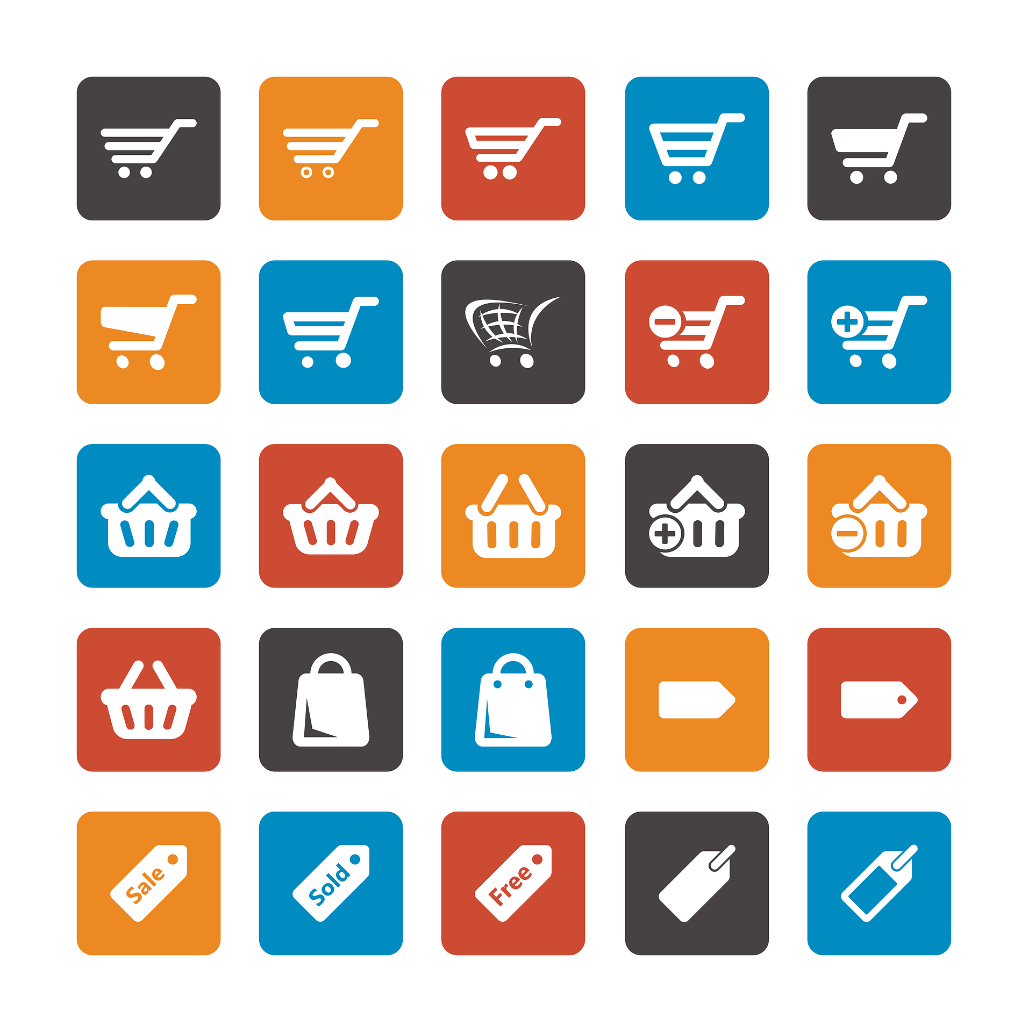
Swimline Diagram

Slide 16

System Context diagram
Notes:
System Context diagram used to understand the interactions of various entities with the Teamee system

Slide 17
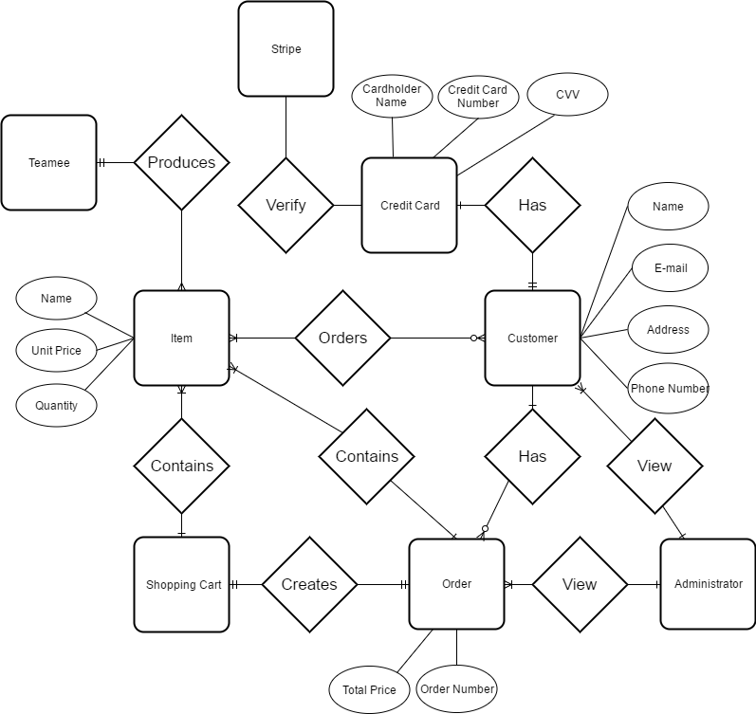

Entity Relationship Diagram (ERD)
Notes:
The ERD shows the relationship between entities within the Teamee system in the database.
An entity relationship diagram (ERD) shows the relationships of entity sets stored in a database. An entity in this context is a component of data. In other words, ER diagrams illustrate the logical structure of databases. An entity–relationship model is usually the result of systematic analysis to define and describe what is important to processes in an area of a business. It does not define the business processes; it only presents a business data schema in graphical form. It is usually drawn in a graphical form as boxes (entities) that are connected by lines (relationships) which express the associations and dependencies between entities. Entities may be characterized not only by relationships, but also by additional properties (attributes), which include identifiers called "primary keys". Diagrams created to represent attributes as well as entities and relationships may be called entity-attribute-relationship diagrams, rather than entity-relationship models.

Slide 18



Trade Study
Quality Attribute | MySQL | MongoDB
Performance | 7 | 7
Ease of Use | 6 | 9
Compatibility | 10 | 0
Supportability | 8 | 5
Scalable | 6 | 9
Reliability | 8 | 5
Total | 45 | 35
Notes:
MySQL and MongoDB were both assigned a 7 for performance since they are about equal because this project is relatively small; thus, it is not expected that there would be huge stores of data. For ease of use, MongoDB was assigned a higher value because it uses dynamic schemas so that it is unnecessary to first define the structure when creating records. Also, one can simply change the structure of records by deleting and adding new fields to the existing ones. MySQL was given a significantly higher rating for compatibility because MySQL is supported by Laravel. In addition, MySQL is better suited as a ecommerce website because it can handle transactions exceptionally well compared to MongoDB. For supportability, MySQL received a higher rating than MongoDB because MySQL is an older and more established DBMS. As a result, it will have more documentations and skilled experts to provide additional assistance. Both DBMS are scalable; however, it is easier to scale using MongoDB. MySQL was given a higher rating for reliability than MongDB because can use ACID which stands for atomicity, consistency, isolation, and durability. These are the four properties of database transactions which are satisfied by MySQL.

Slide 19
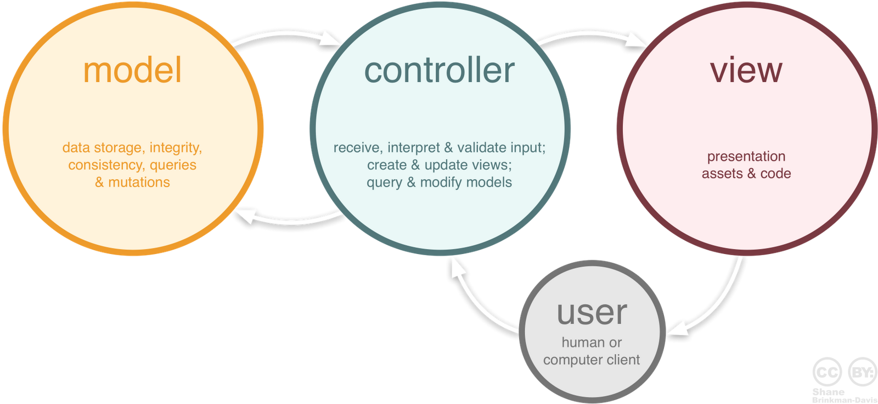

Laravel
PHP web framework
Model-view-controller (MVC)
Created by Taylor Otwell
Supports MySQL
New feature Cashier
Notes:
Laravel is a free, open-source PHP web framework, created by Taylor Otwell and intended for the development of web applications following the model–view–controller (MVC) architectural pattern. Model–View–Controller (MVC) is a softwarearchitectural pattern for implementing user interfaces on computers. It divides a given application into three interconnected parts in order to separate internal representations of information from the ways that information is presented to and accepted from the user.
Cashier, introduced in Laravel 4.2, provides an interface for managing subscription billing services provided by Stripe, such as handling coupons and generating invoices.

Slide 20
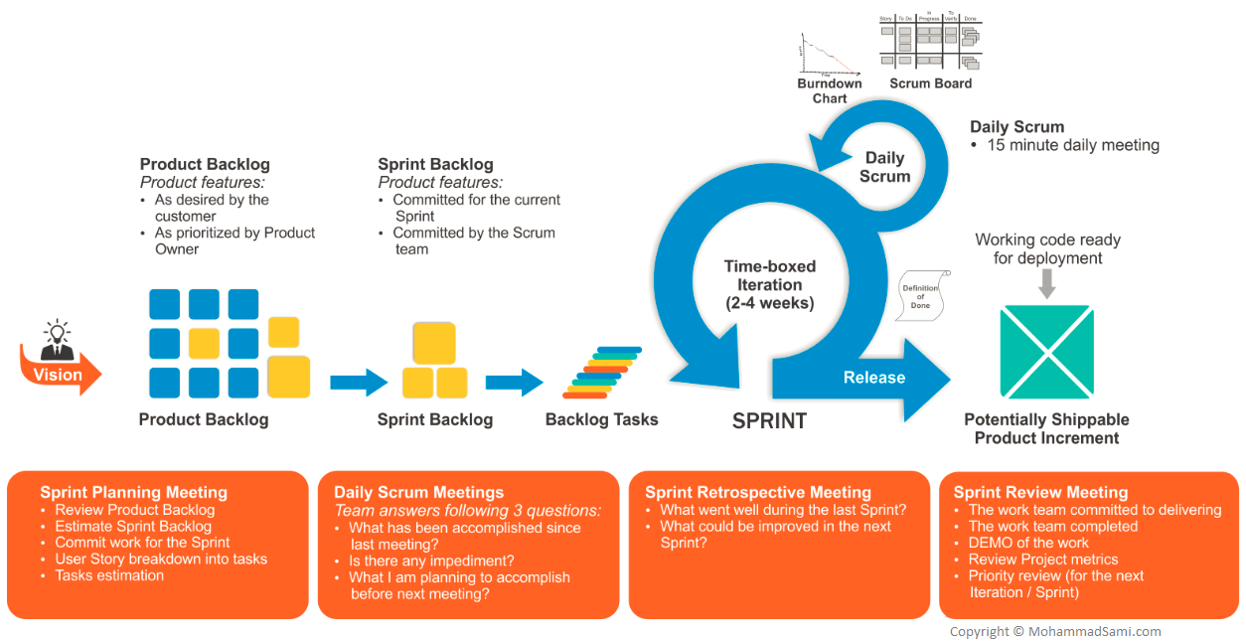
Scrum
Notes:
The cycle repeats until enough items in the product backlog have been completed, the budget is depleted, or a deadline arrives. Which of these milestones marks the end of the work is entirely specific to the project. No matter which impetus stops work, Scrum ensures that the most valuable work has been completed when the project ends.
Scrum is an Agile software development methodology that is use to develop applications.
It focuses on teamwork
and daily face to face meetings. The Scrum process is an empirical
process that is flexible and adaptive to changes rather than a set detailed planning. There are four
3
phases in Scrum lifecycle:
planning, staging, development, and release. In the Scrum process,
there is a scrum team that is composed of a Scrum Master, the Product Owner, and the
Development Team. Scrum teams are based on the value of respect, honesty, courage, focus,
trust, and openness. Therefore, scrum teams meet daily in a common room to discuss their
progress and to answer special questions. On average, meetings lasts 1520
minutes but it could
also be longer. Additionally, the average project length of a timeboxed iteration is about 4
weeks. Scrum artifacts are the product backlog, sprint backlog, and potentially shippable
products that are created in increments through each sprints.

Slide 21
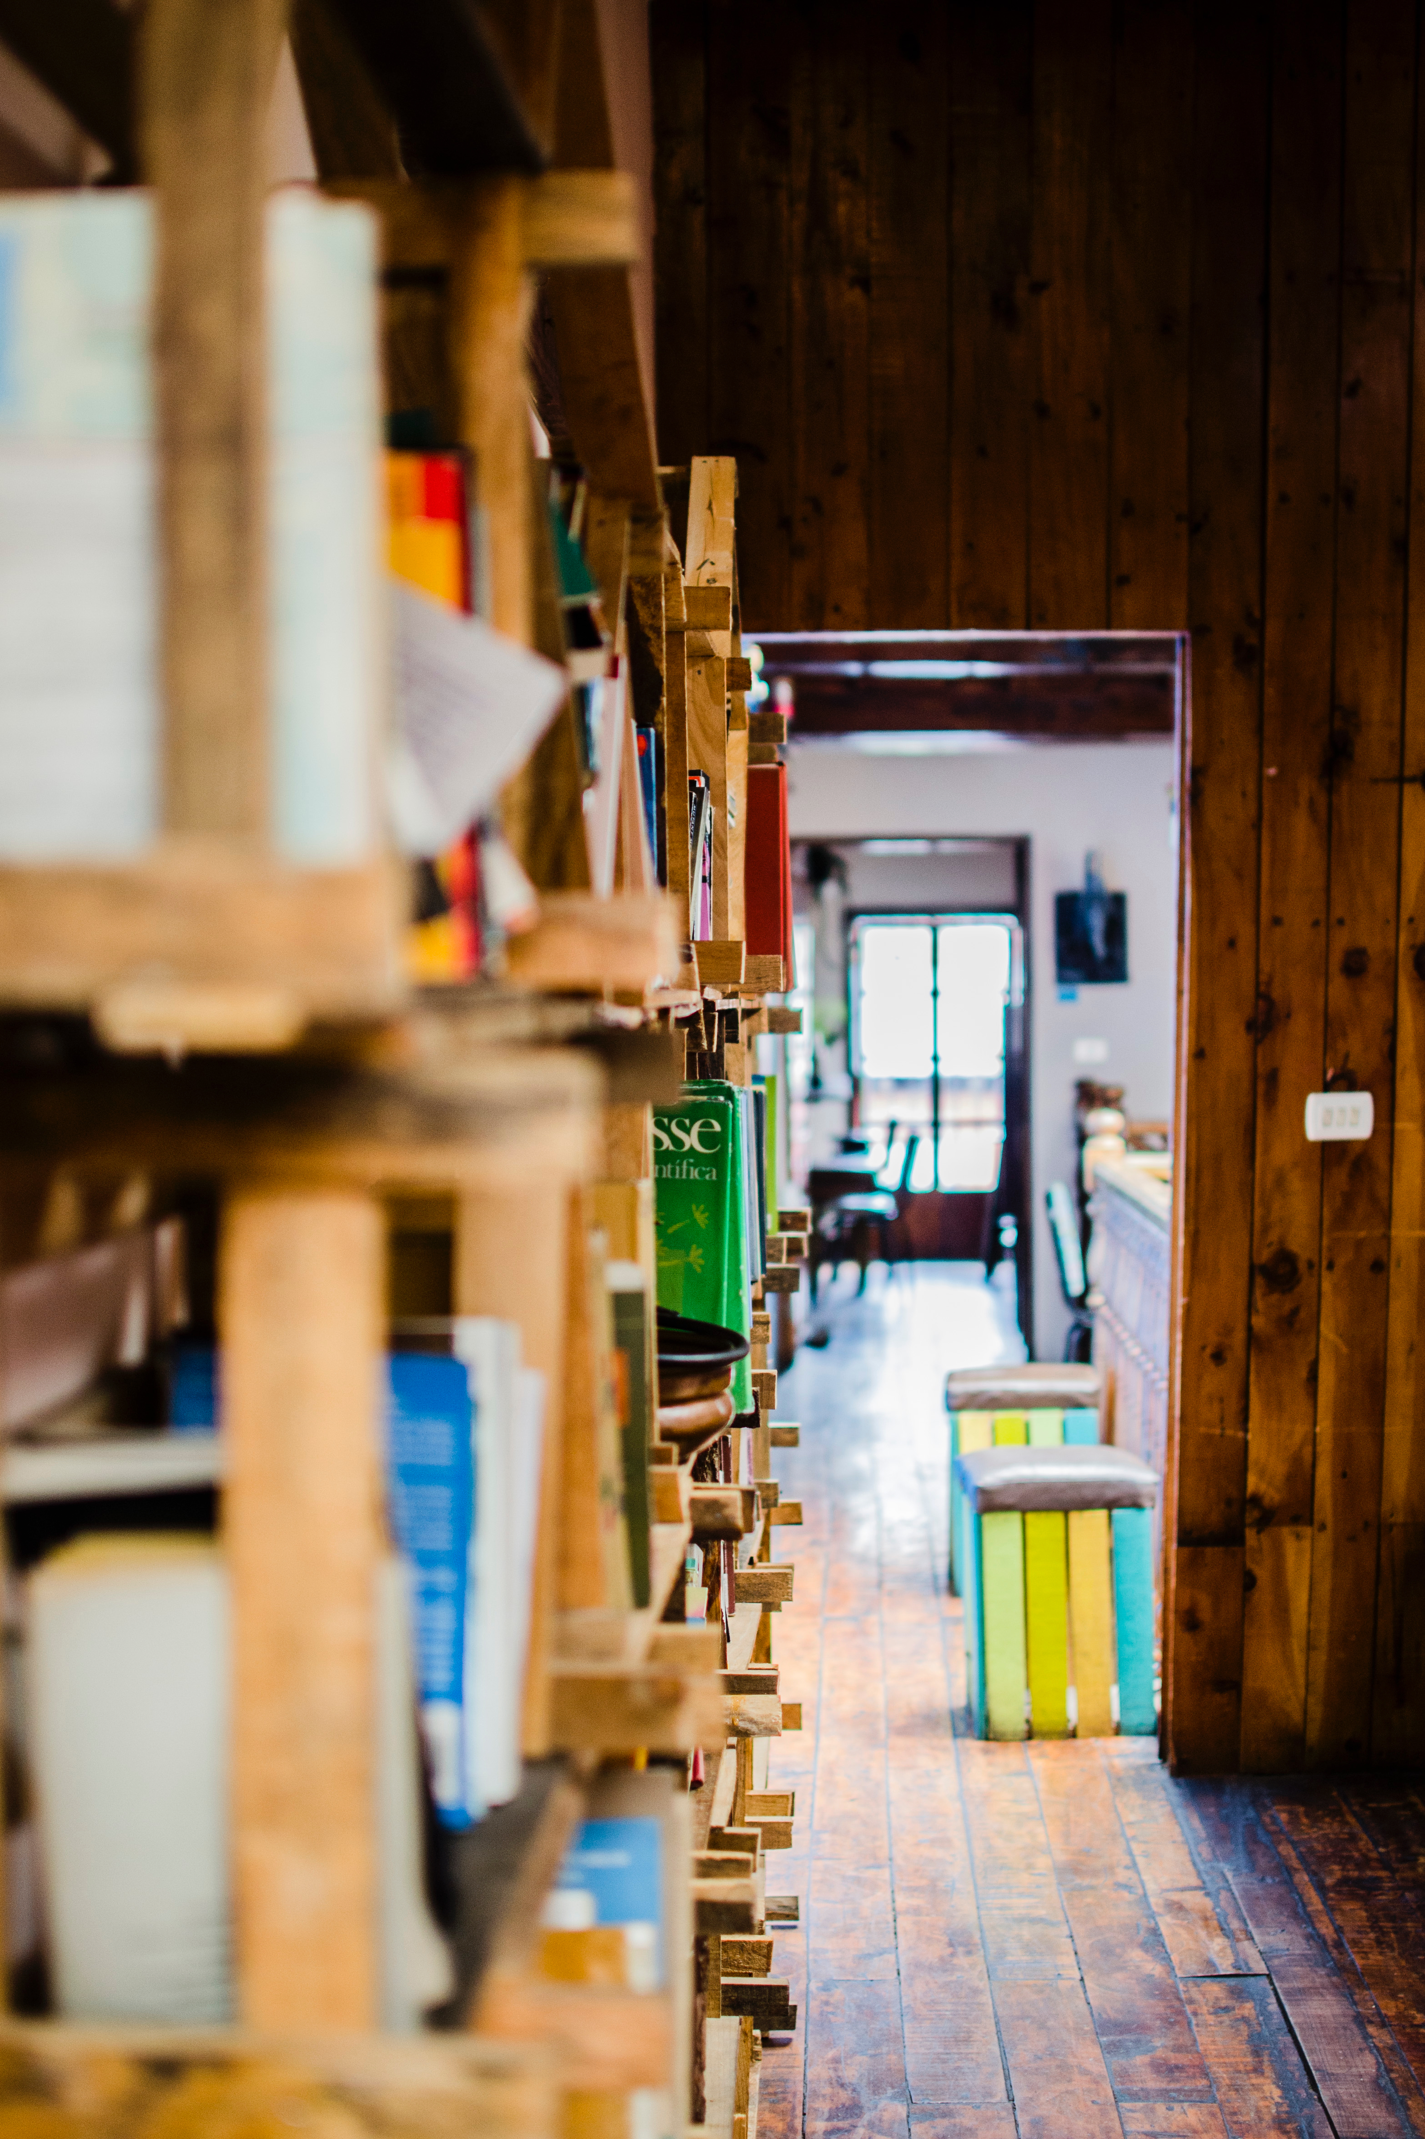
Work Products
There are four work products associated with Scrum. The four work products are:
Product Increment
Sprint Backlog
Product Backlog
Burndown Chart
Notes:
Product Increment
The product increment is the product that is released after each sprint. The product should be a potentially shippable product that the customer can use and provide feedback upon. The product should contain all the use stories included in the sprint backlog. In addition, the product should be tested and documented.
Product Backlog
The product backlog contains all the items that are necessary to complete the product. It represents what will be built. The items in the product backlog are flexible to change. Items in the product backlog can include features, use cases, enhancements, defects, and technologies.
Sprint Backlog
The sprint backlog contains items from the product backlog. Items placed in the sprint backlog are considered the goals for that sprint. Items on the sprint backlog are delivered at the end of the sprint. At the end of each sprint, items for the next sprint are put into the sprint backlog. The categories for the sprint backlog are “Pending”, “Working On”, and “Completed”. All items began at pending, and are moved to working on when it is being implemented. Then after the item is finished and tested, it is moved to the completed section.
Burndown Chart
The burndown chart is demonstrated the amount of work remaining across time. This chart is also used to keep track of the progress made throughout each sprint. Moreover, it is also used to reflect the progress made against the product backlog. The burndown chart is updated throughout the length of the sprint.

Slide 22
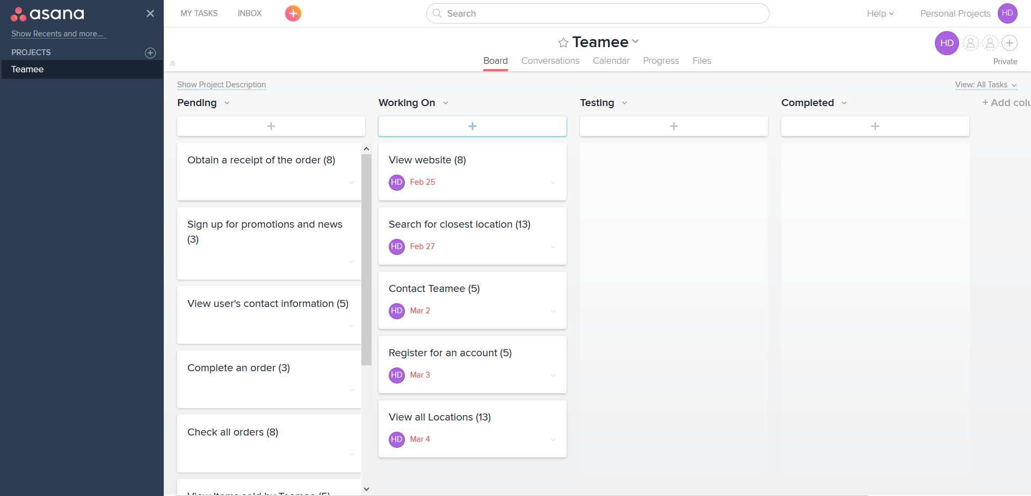
Asana Sprint Backlog
Notes:
During the sprint planning for the first iteration, a set of use cases were selected and moved to the “Working On” section. These cases were chosen based upon their high risk and priority. View website was chosen because a basic UI layout was needed in order for the users to use the website. View all locations and Search for the closest location was chosen because they were deemed at a high risk due to my unfamiliarity with using Google map API. Register for an account was also chosen because it would be one of the first function that a new user would utilize. The figure below showed the backlog for Iteration 1 with the five use cases to be implemented.

Slide 23
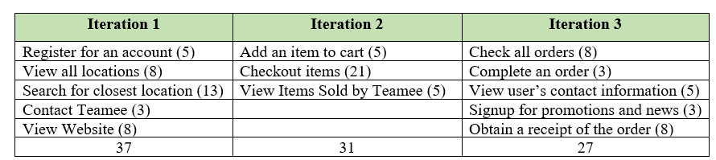
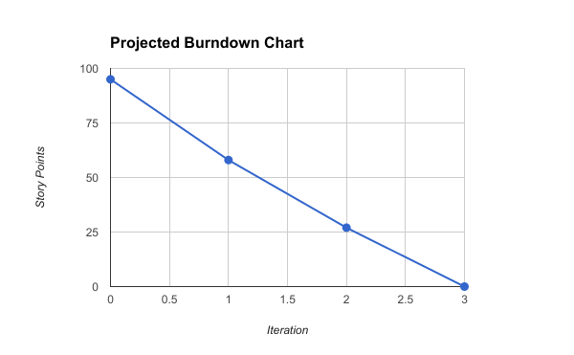
Charts and Graph
Name | Description | Story Points
View website | As the user, I want to be able to view the Teamee website on my internet browser | 8
Register for an Account | As the user, I want to be able to register for an account on Teamee so that I can view my orders. | 5
Add item to cart | As the user, I want to be able to add an item to cart so that I can checkout my orders after I am done shopping. | 5
Checkout items | As the user, I want to be able to checkout my items in my shopping cart so that I can pay and pick up my order at the store. | 21
Search for the closest location | As the user, I want to be able to search for the closest Teamee store so that I can know which store to select to pick up my order. | 13
View all locations | As the user, I want to be able to view all of Teamee’s locations so that I can plan a trip to any Teamee location. | 8
Contact Teamee | As the user, I want to be able to contact Teamee so that I can ask a question or leave a comment. | 3
Sign up for promotions and news | As the user, I want to be able to sign up for promotions and news from Teamee because I am a fan of Teamee and I want to get any savings from Teamee. | 3
Obtain a receipt of the order | As the user, I want to receive a receipt of my order in case something goes wrong or for my spending records. | 8
View Items sold by Teamee | As the user, I want to be able to view all items sold by Teamee so that I can order the items that I want. | 5
Check all orders | As the admin, I want to be able to look up all the current pending orders so that I can fulfill them and satisfy my customers. | 8
Complete an order | As the admin, I want to be able to complete an order so that it can go to the completed section and I can keep track of my orders properly. | 3
View user’s contact information | As the admin, I want to be able to view the user’s contact information so that I can contact them if something is wrong. | 5
Notes:
All the functional requirements were placed into the product backlog with a description set as the user story. A story point is assigned to each functional requirement based upon the Fibonacci sequence. The Fibonacci sequence was used because it helped provided a relative estimate of each user story to create a more accurate estimate. Register for an account was used as the benchmark to compare the other user stories.
4.5 Release Plan
A release plan was created after the product backlog was completed. The release plan was created based upon the set timeline with 3 iterations. Each iteration was timeboxed to two weeks due to time constraint.
Prodjected burndown chart
Based upon the product backlog chart that was produced, a projected burndown chart is created. This projected burndown chart will be used to measure the developmental progress. The total number of story points was 95 and after the first iteration it was expected that 37 story points should be completed. Then after the second iteration, another 31 points should be completed leaving only 27 story points for the last iteration.

Slide 24
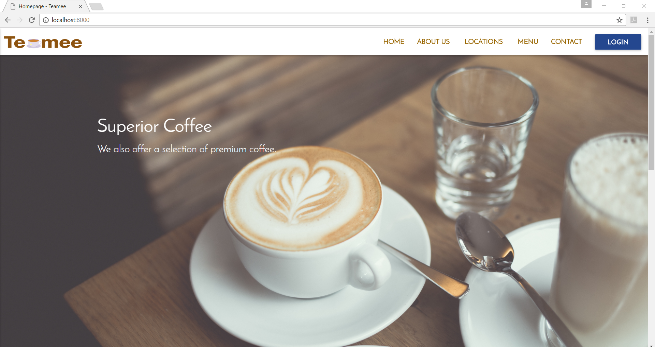
Homepage

Slide 25
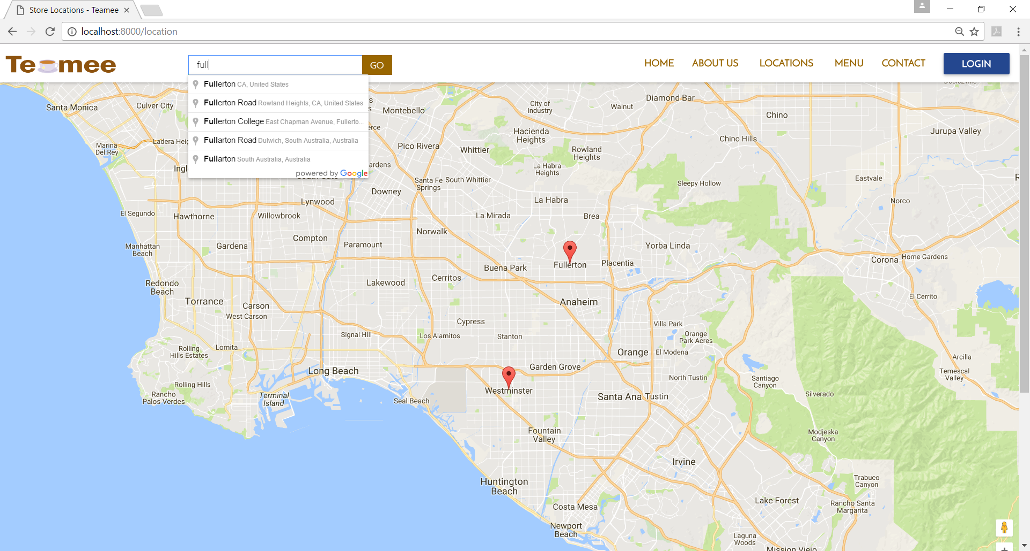
Locations

Slide 26
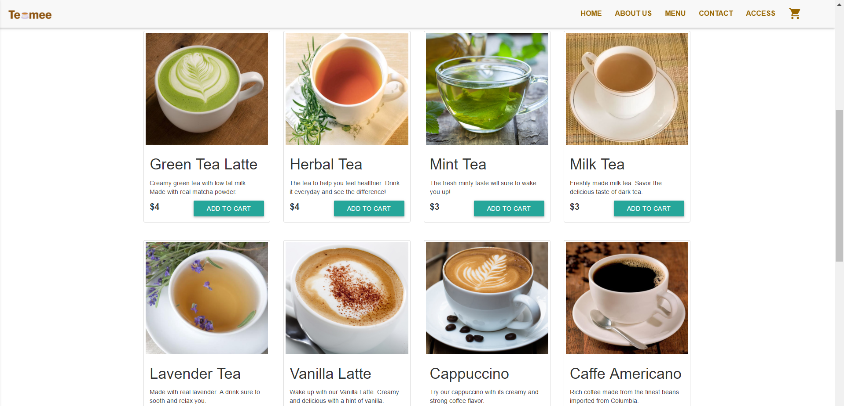
Menu

Slide 27


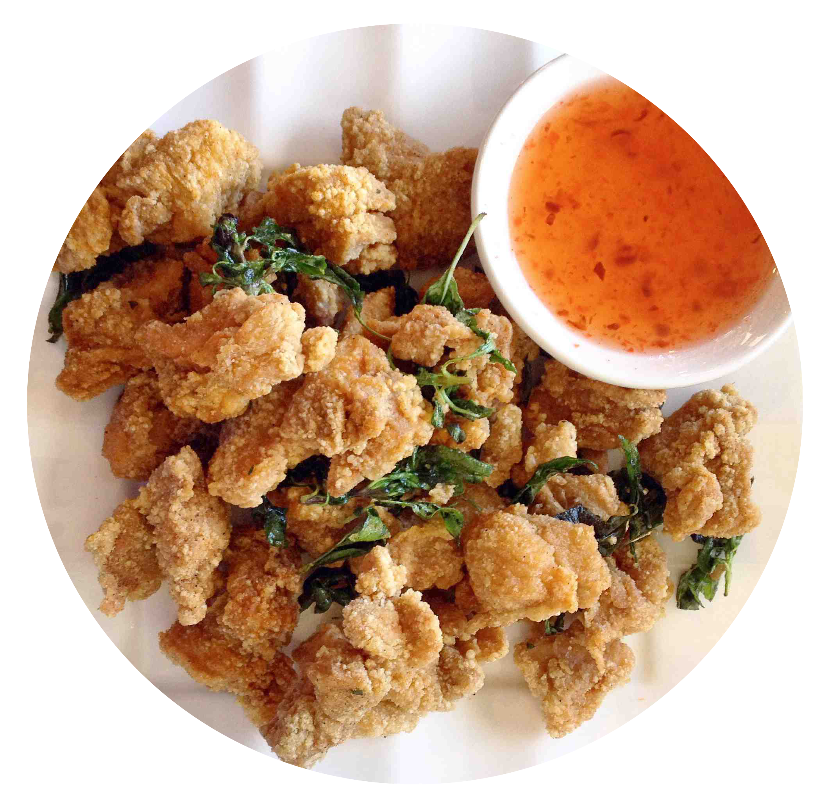
Milk Tea
Green Tea
Lavender Tea
Herbal Tea
Mint Tea
Vanilla Latte
Cappuccino
Caffe Americano
Tuna Sandwich
Garlic Fries
Fruit Tart
Chocolate Chip Cookies
Items sold by Teamee

Slide 28
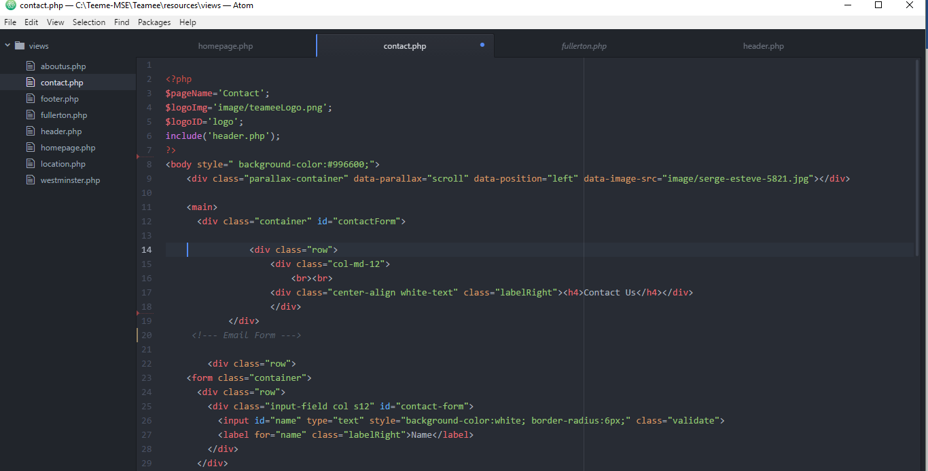
Contact page code

Slide 29
Iteration 2

Slide 30
Conclusion
The global and digital world makes it necessary for any business to have a website. Internet access is widely available now which makes it easier for businesses to promote their product online.⁹ The convenience of online shopping has made ecommerce a blooming industry. ⁷ Ecommerce stores are beginning to rival brick and mortar stores as more users are discovering the ease of online shopping.¹⁰ Fast shipping and enticement such as skipping the line, also encourages more users to order online.
An attractive and user friendly website could become a company’s face in the global market.⁶ A website can contain information about the company and its products to help promote its services. Having an exemplary website is like having an excellent salesman, who can convince customers to buy its products. Thus, it is essential to develop a website that would be appealing and informational.

Slide 31

References
1. Bass, Len, Paul Clements, and Rick Kazman. Software Architecture in Practice, 2nd ed. Addison-Wesley Professional, 2003.
2. Cordova. Apache. https://cordova.apache.org/ Accessed January 13, 2017.
3. Daniel Simon Sanz and Ankur Agrawal, “Automated Menu Recommendation System Based on Past Preferences” International Journal of Advanced Computer Science and Applications(IJACSA), 5(7), 2014
4. E-Commerce & Online Shopping Auctions in the US. IBISWorld. June 2016. Online Report. Accessed January 13, 2017.
5. Kaplan, Jeff. Changing Channels: new ways to do business. Network World. March 5, 2007; 24, 9; ABI/INFORM Collection page 25. News article.
6. King, David Lee. Designing the Digital Experience: How to Use Experience Design Tools and Techniques to Build Websites Customers Love. Information Today, Inc. 2008. Print.
7. McPherson, Doug. Worldwide E-commerce Sales to Rise Nearly 20 Percent This Year.
8. Wiegers, Karl, Software Requirements (3rd Edition ), Microsoft Press 2013.
9. Winter, S.J. Inf Syst E-Bus Manage (2012) 10: 279. doi:10.1007/s10257-011-0165-5.
10. WorldPay. The Global Rise in ‘Always-On’ Shoppers Driving eCommerce. Online report. April 25, 2012.

